Slide 1

CPS training

Slide 2


Slide 3
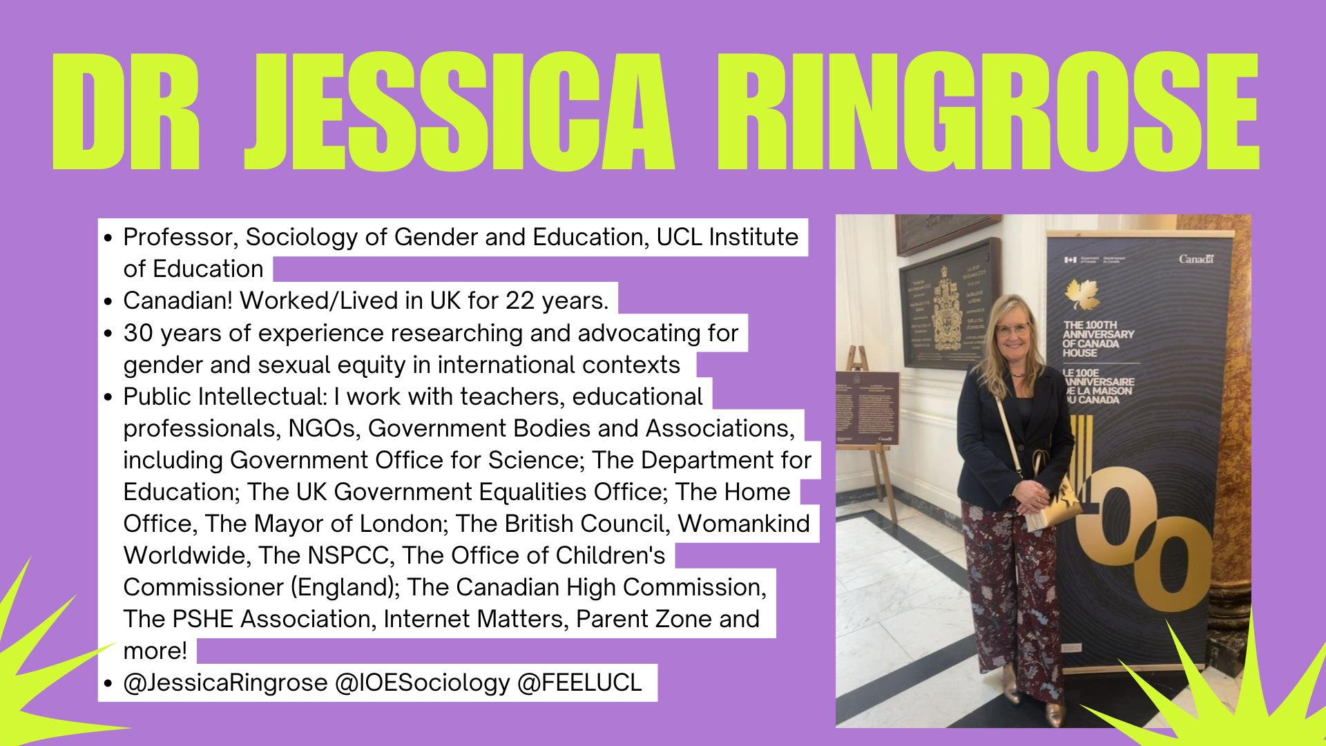

Slide 4
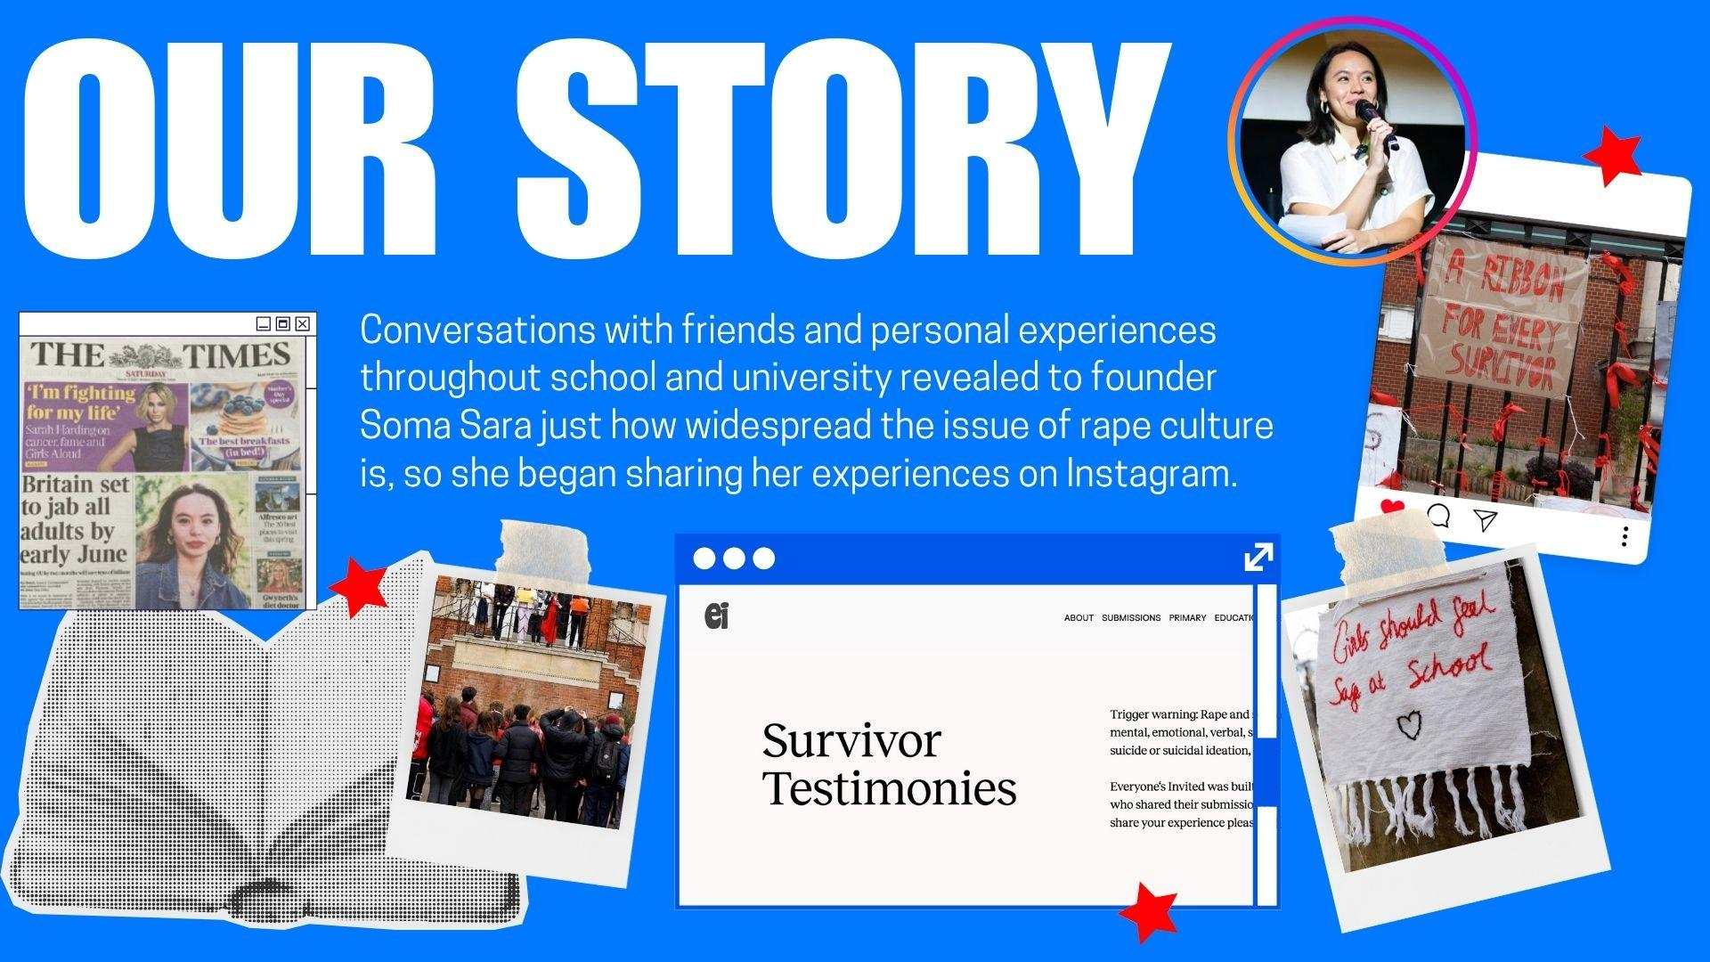

Slide 5
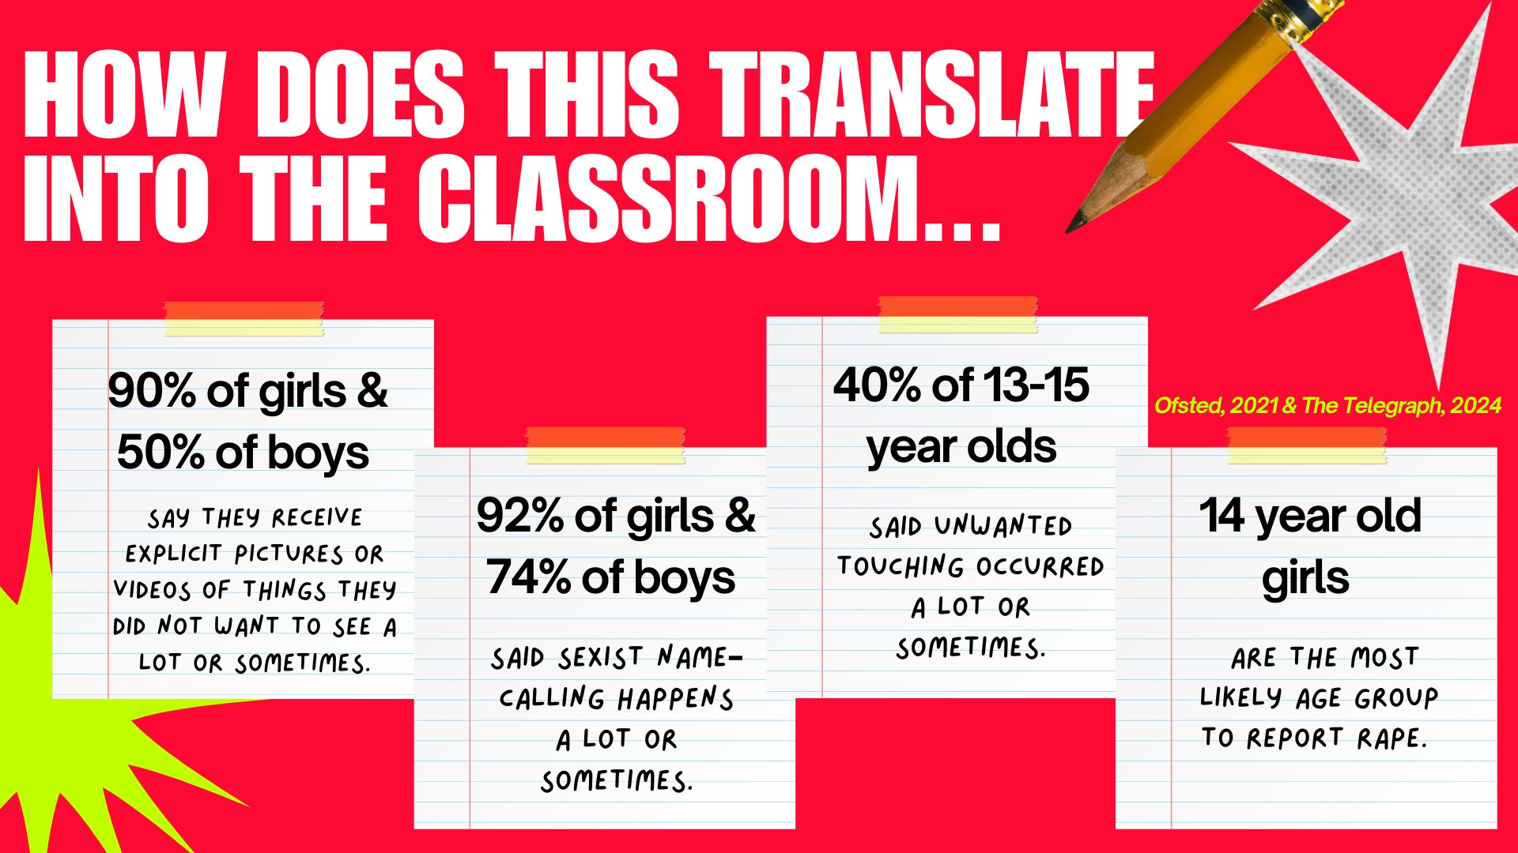
Why are we talking about this →
On the rise slides - add in this is translating directly into the classroom and THEN
Oftsted report → girls aged 14 most likely to report rape, public transport in london girls study

Slide 6
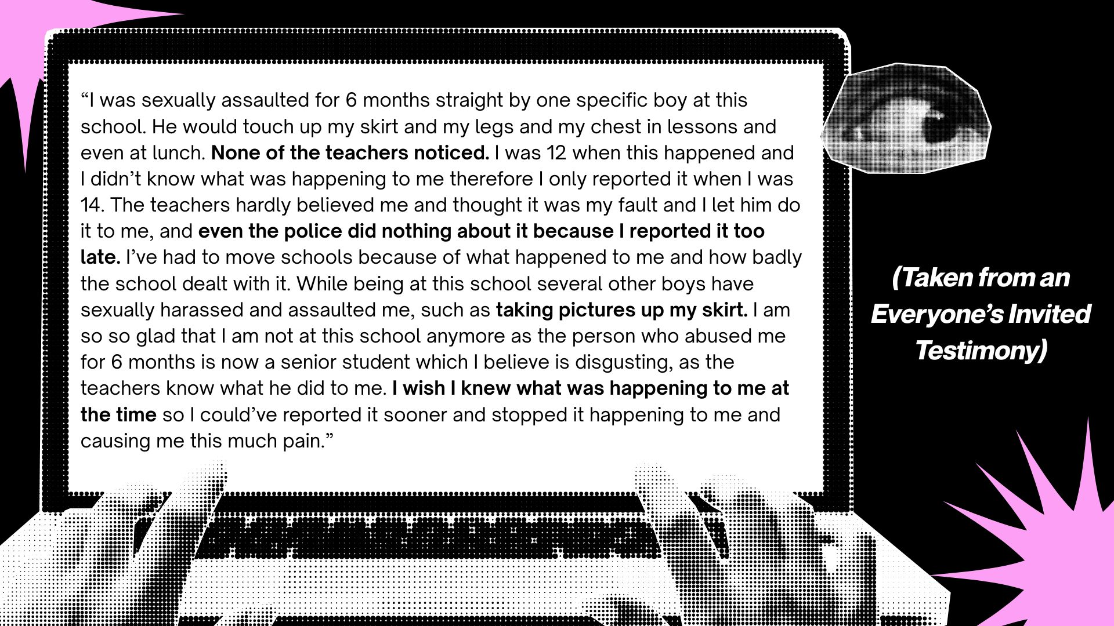

Slide 7


Slide 8


Slide 9
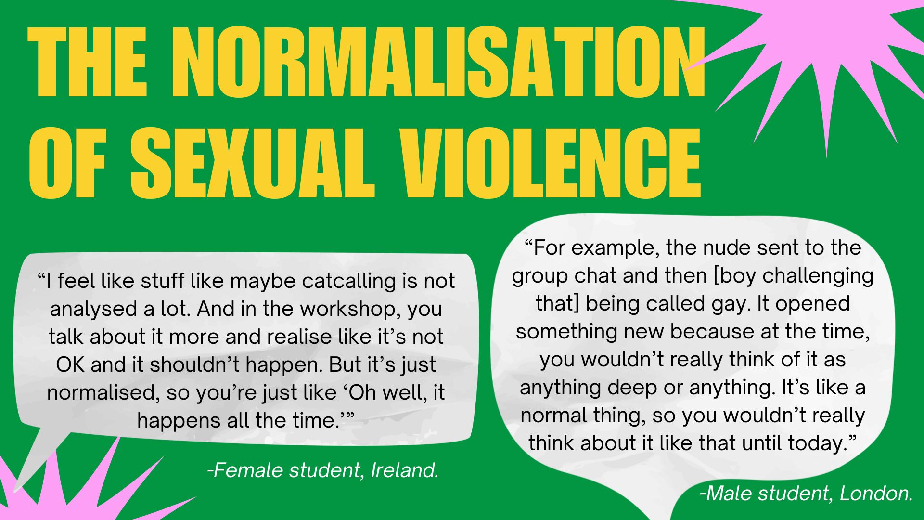
Notes:
The normalisation of sexual violence

Slide 10


Slide 11
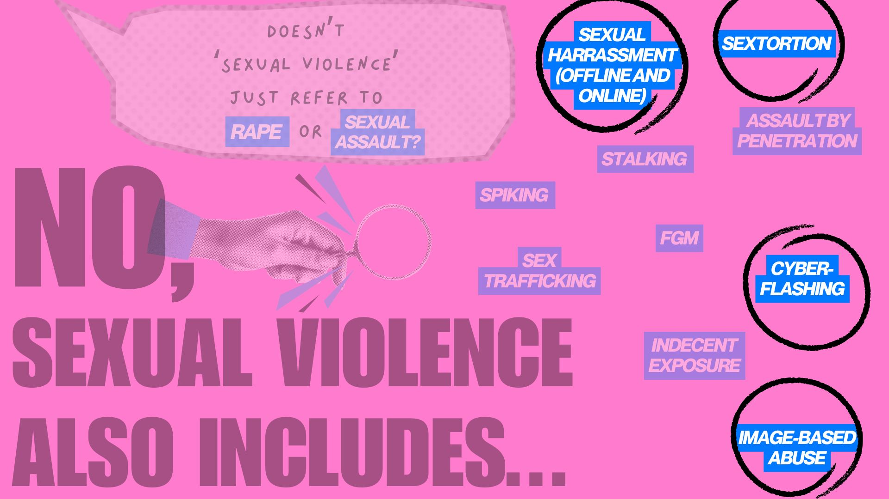

Slide 12
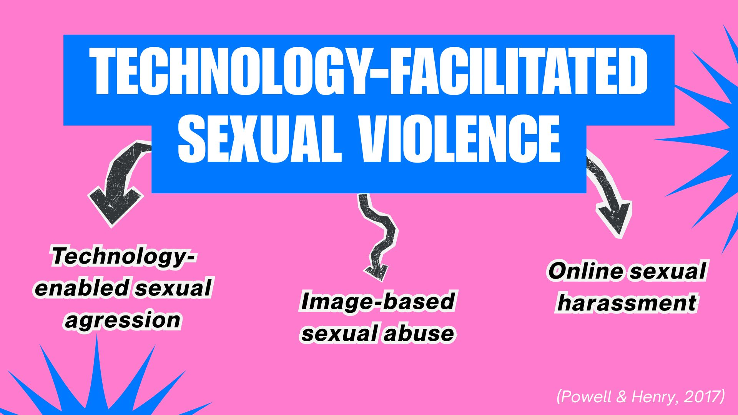

Slide 13
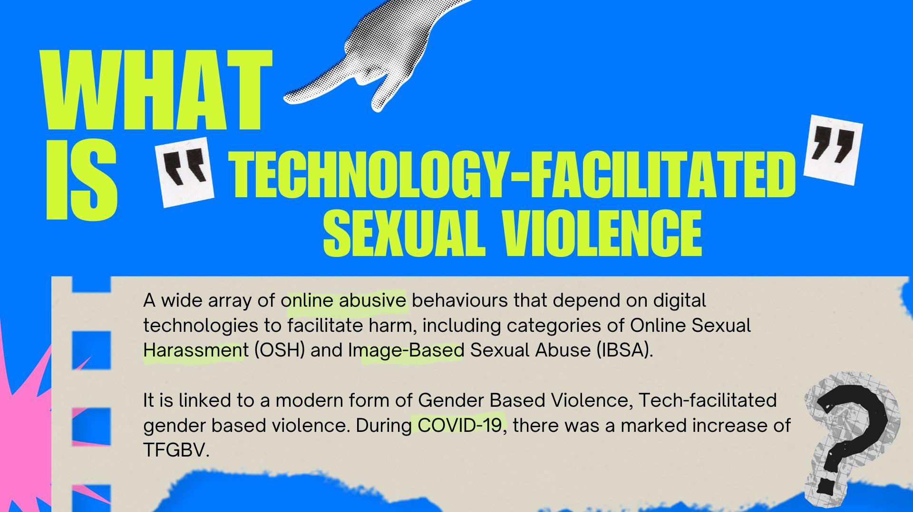

Slide 14
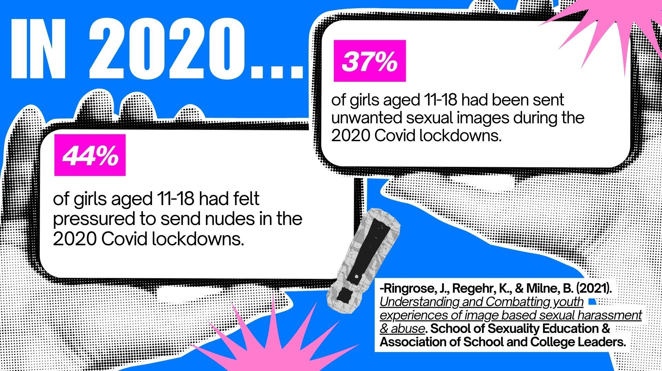

Slide 15
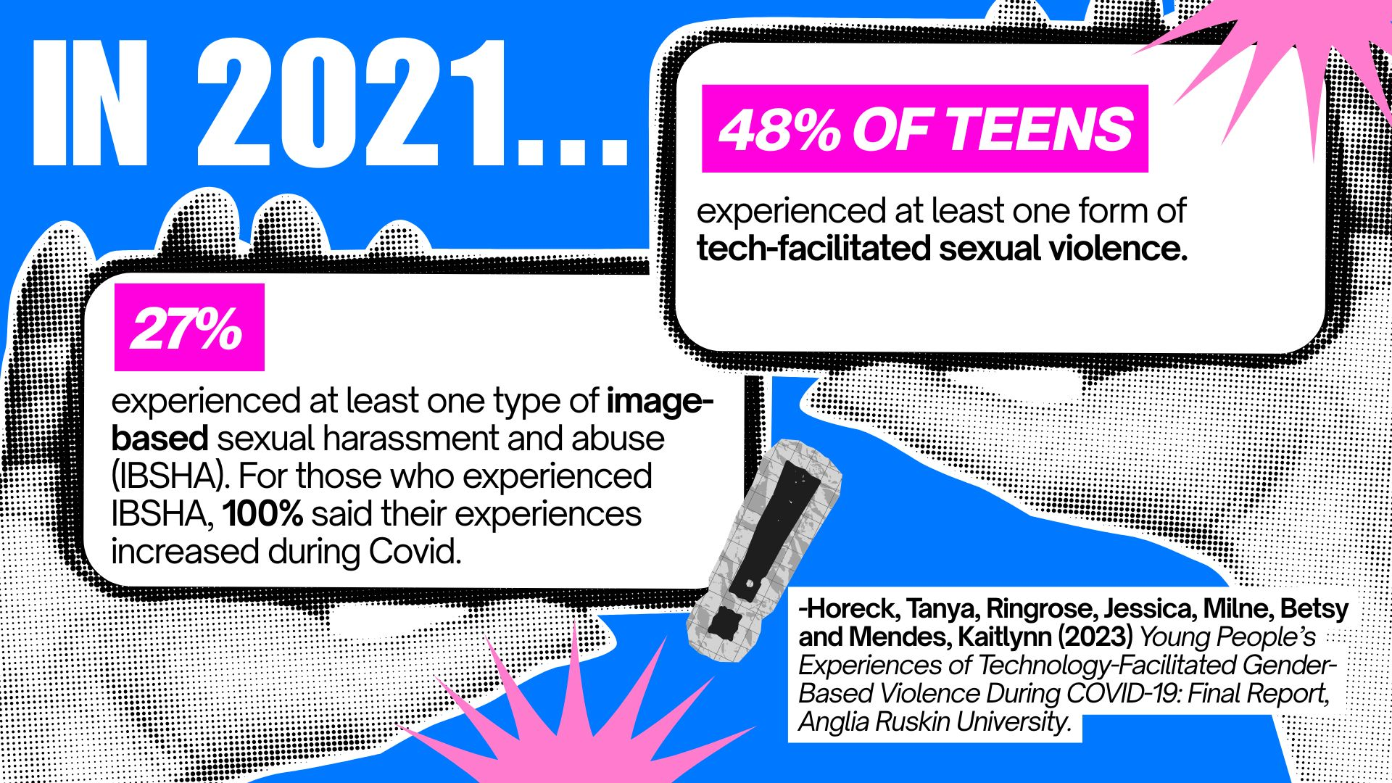
Notes:
Speaker notes: These results informed the Online safety act and a new suite of crimes on intimate image abuse, and the creation of a new offence on cyberflashing in 2022. It is critically important that the legal system keep up with the pace of cybercrimes. However, these offences are not enough. And moreover, the law applies a blanket approach to under 18s so that any offences are categorised as child sexual abuse.

Slide 16
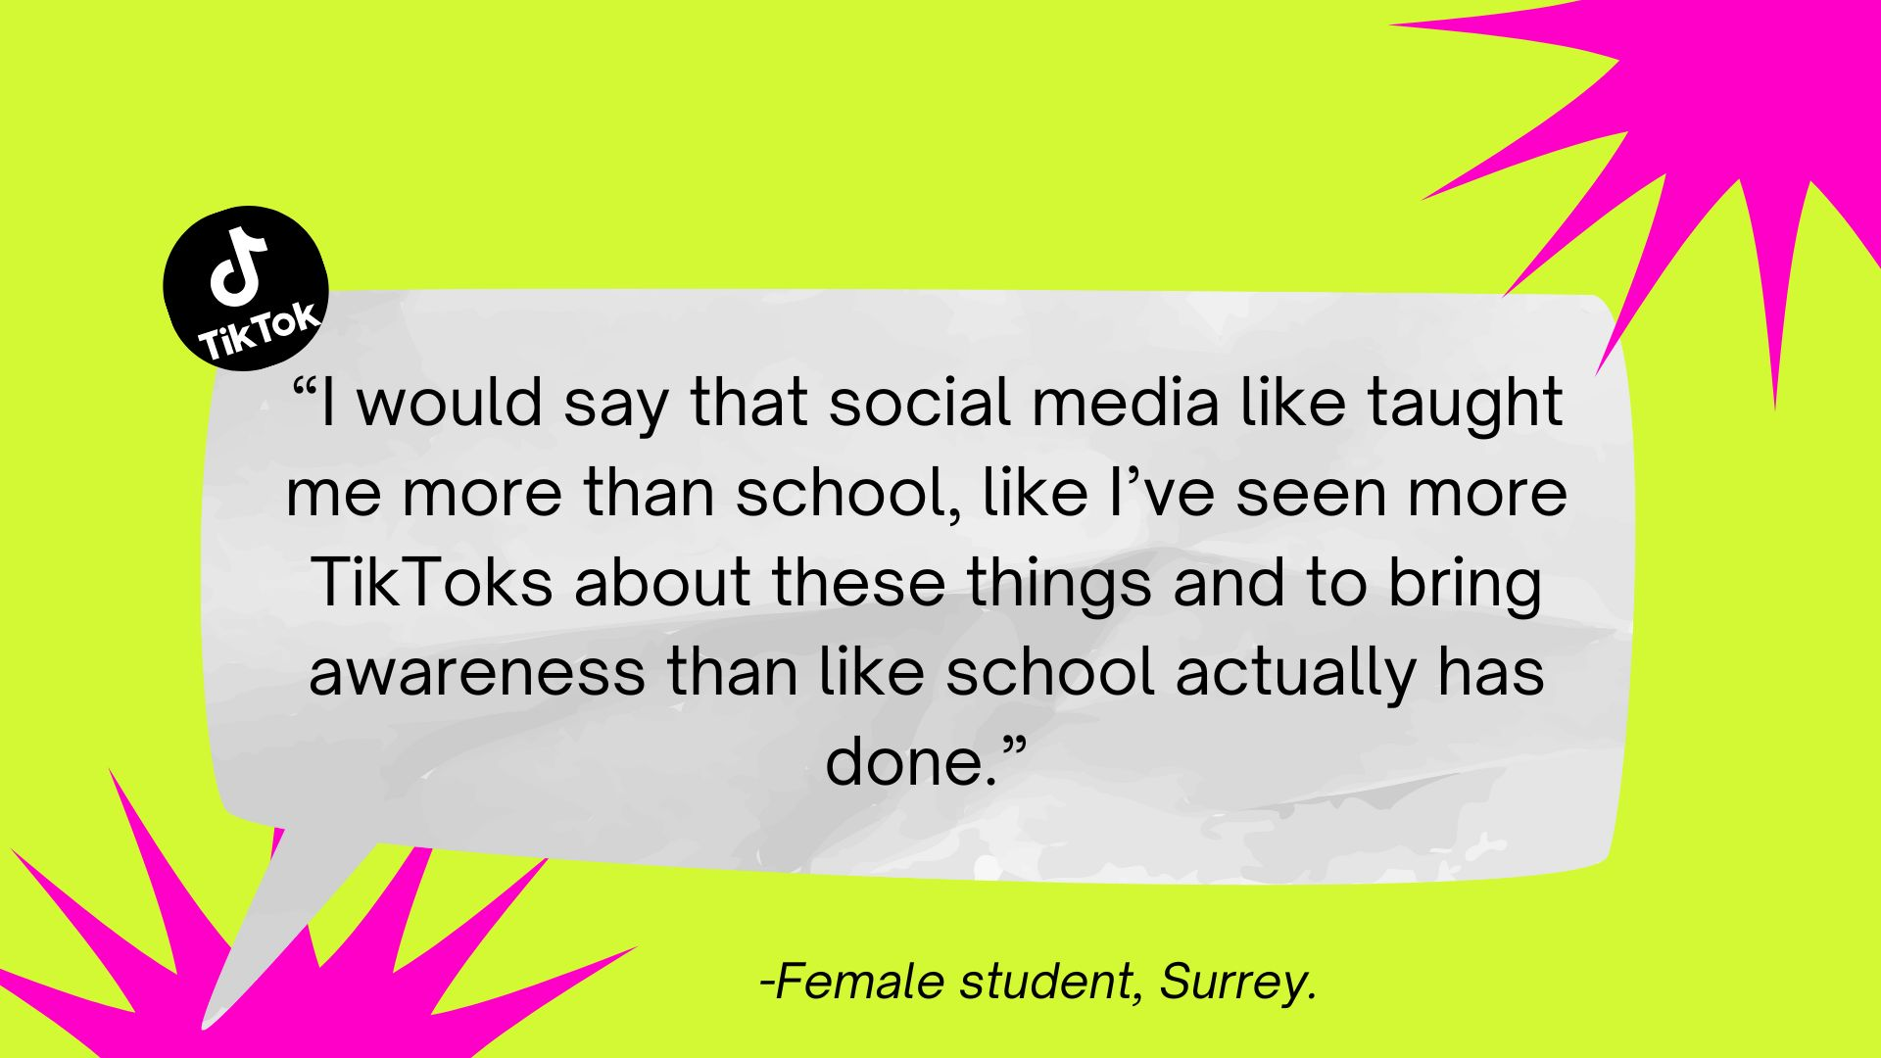

Slide 17
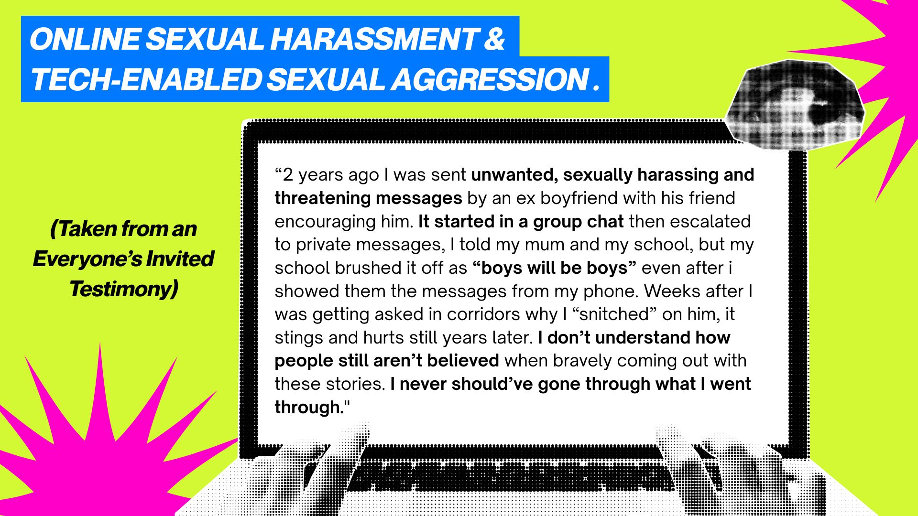

Slide 18


Slide 19
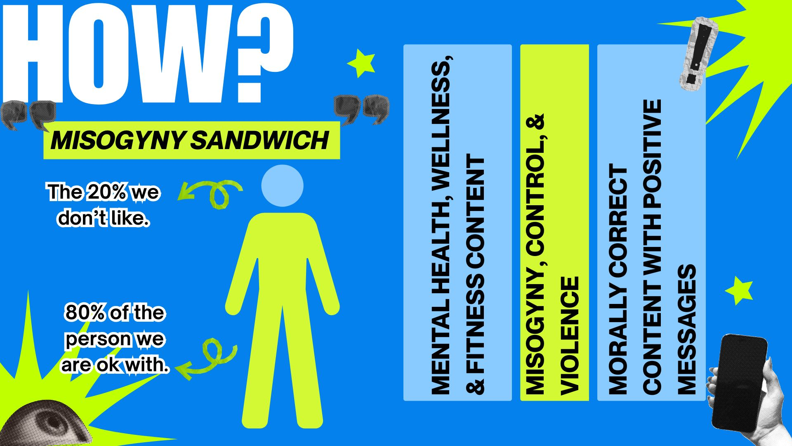
Notes:
Less context

Slide 20
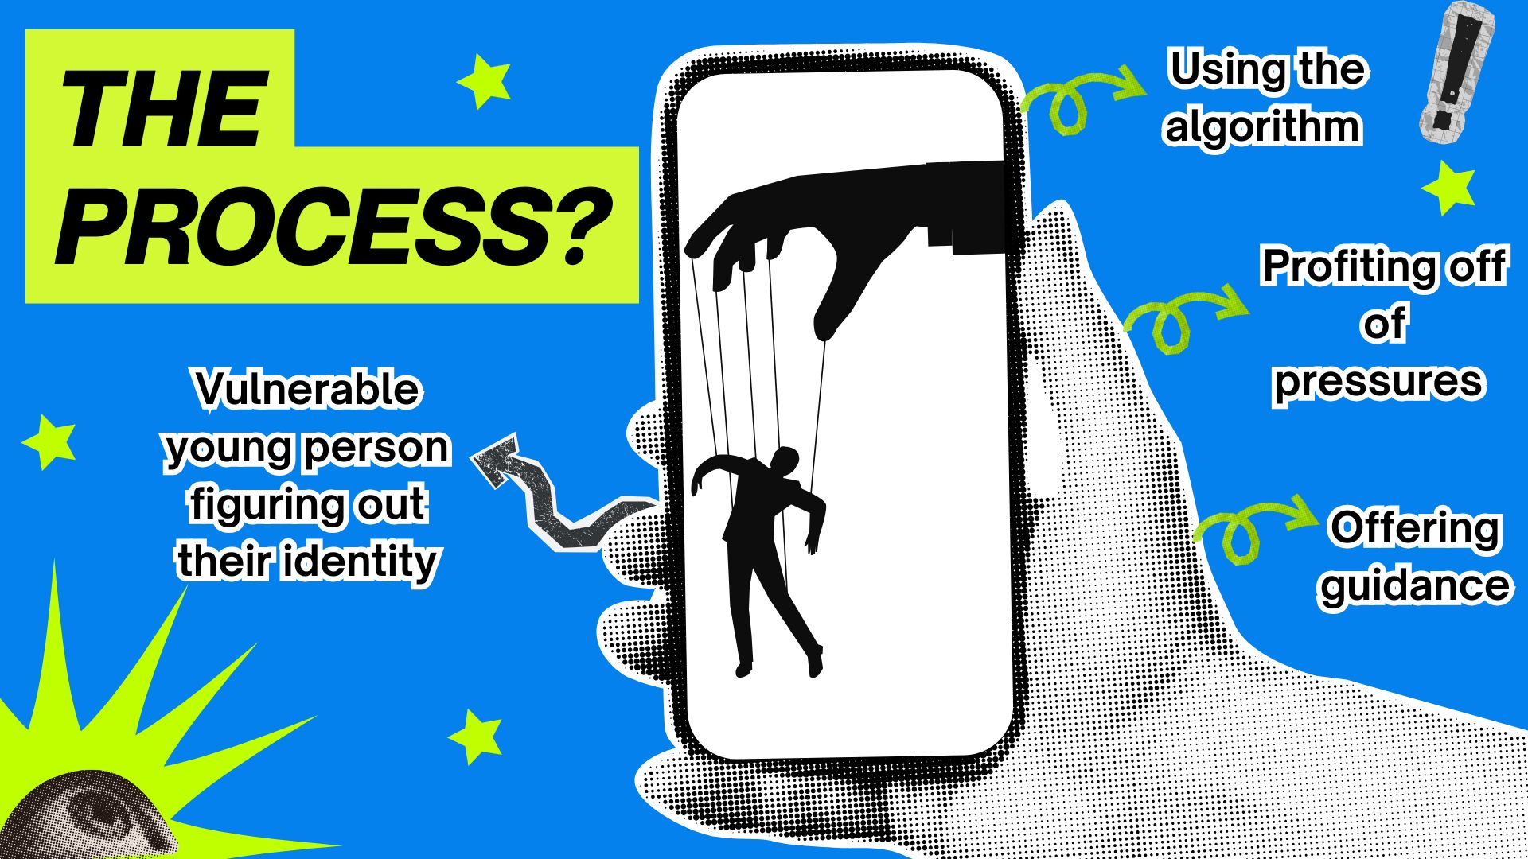

Slide 21
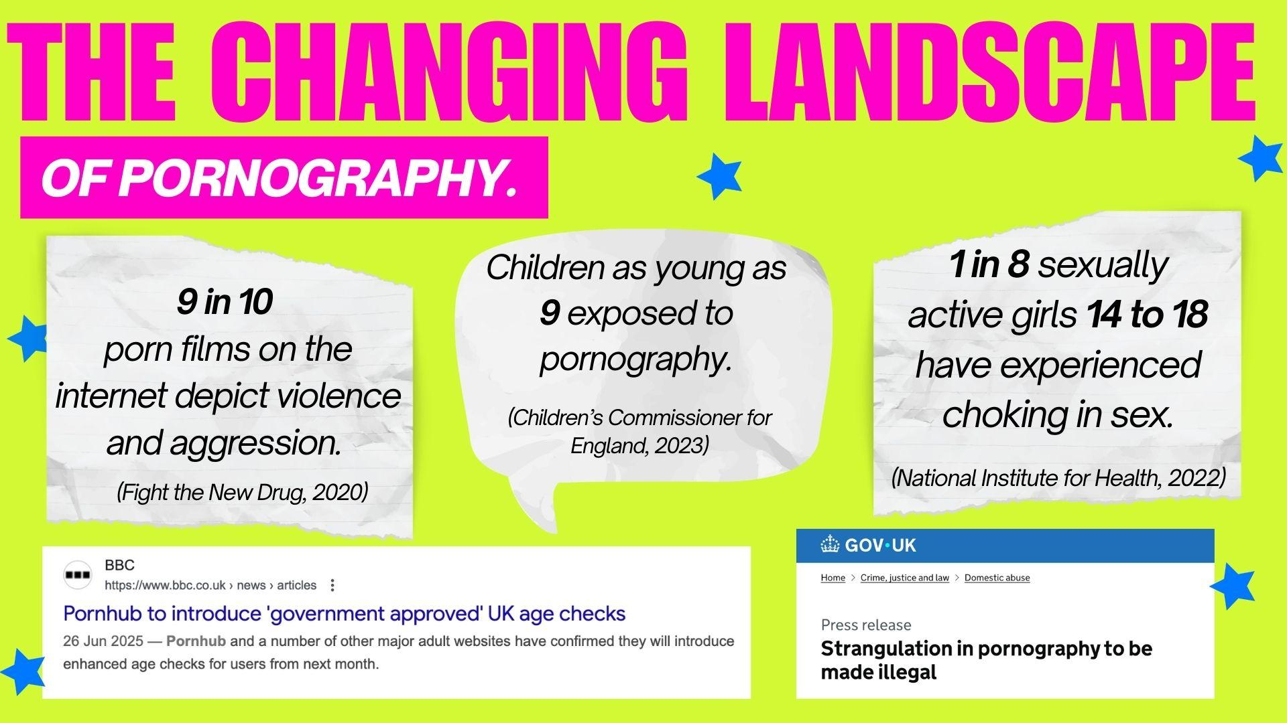
Notes:
Including SEF strangualtion docs

Slide 22
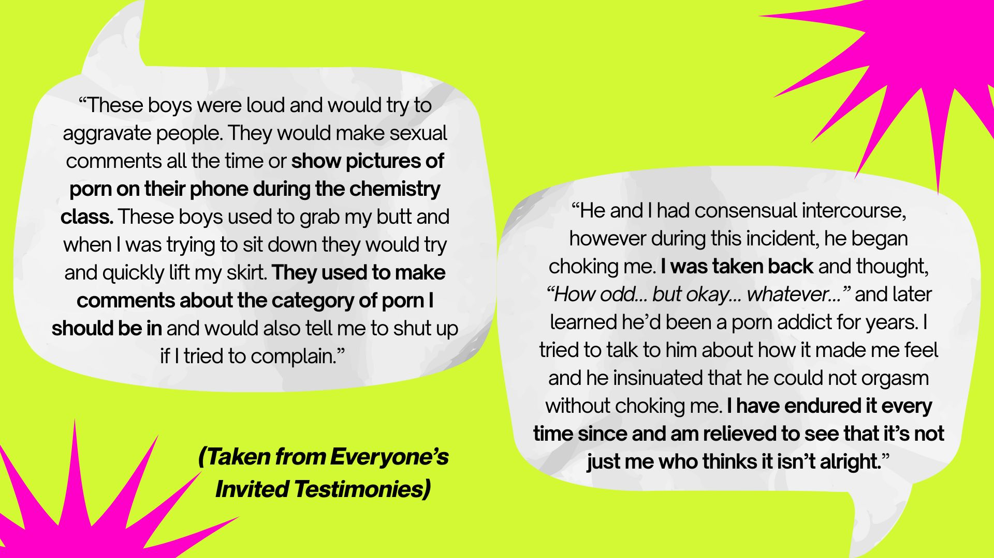

Slide 23
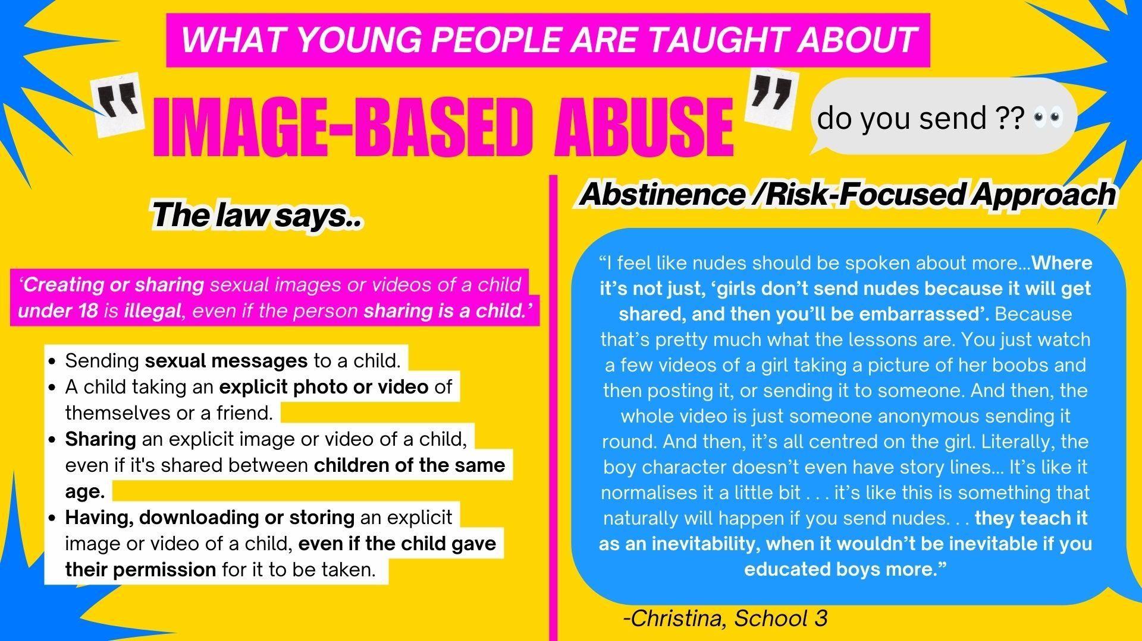

Slide 24
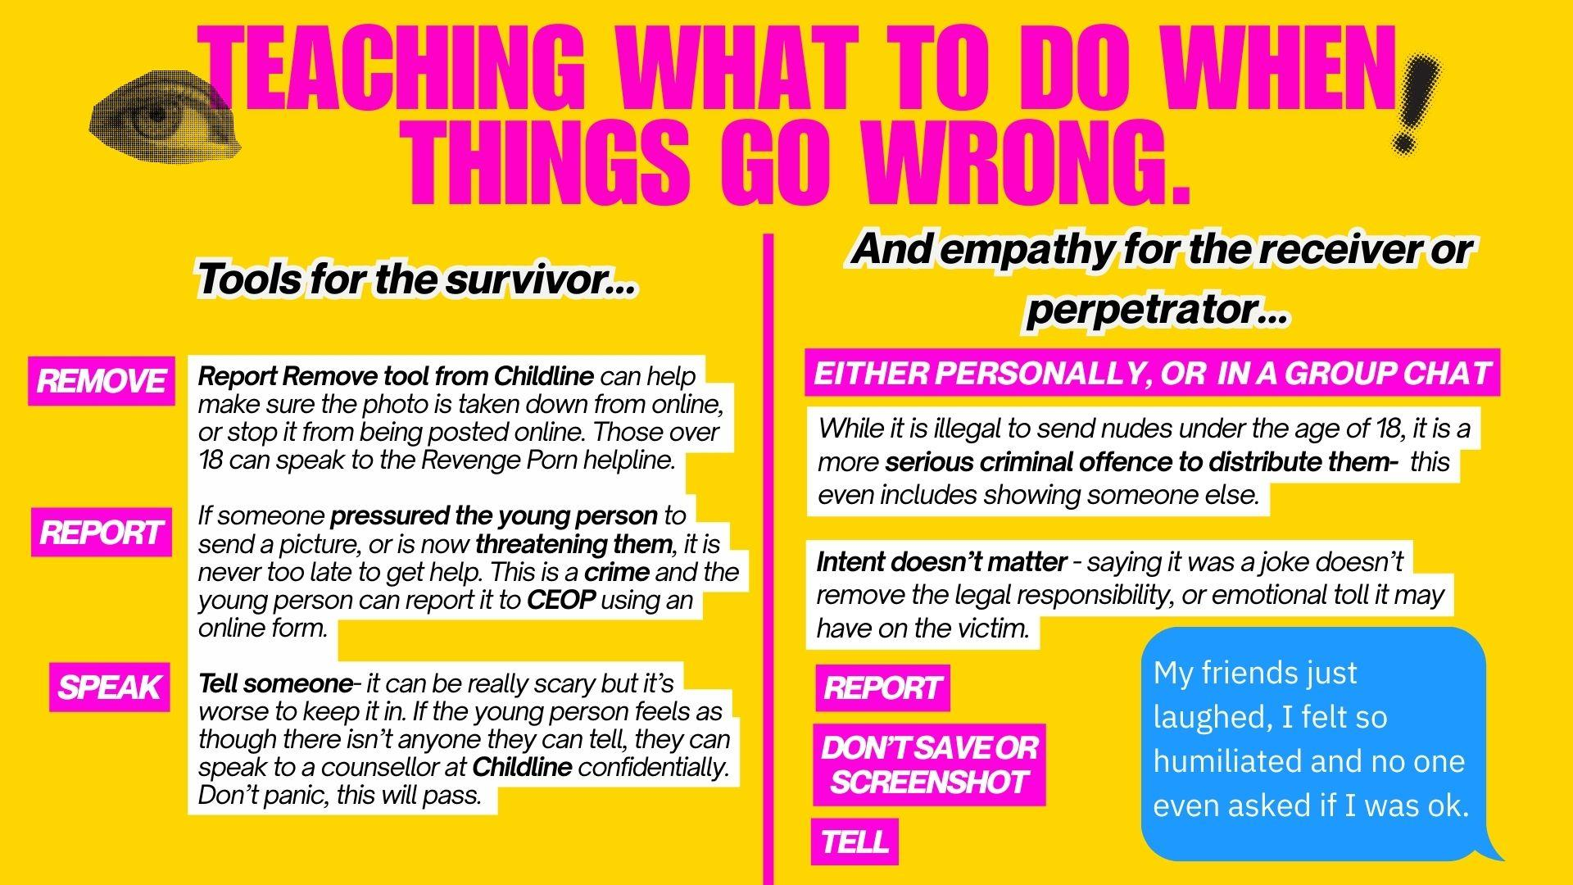

Slide 25
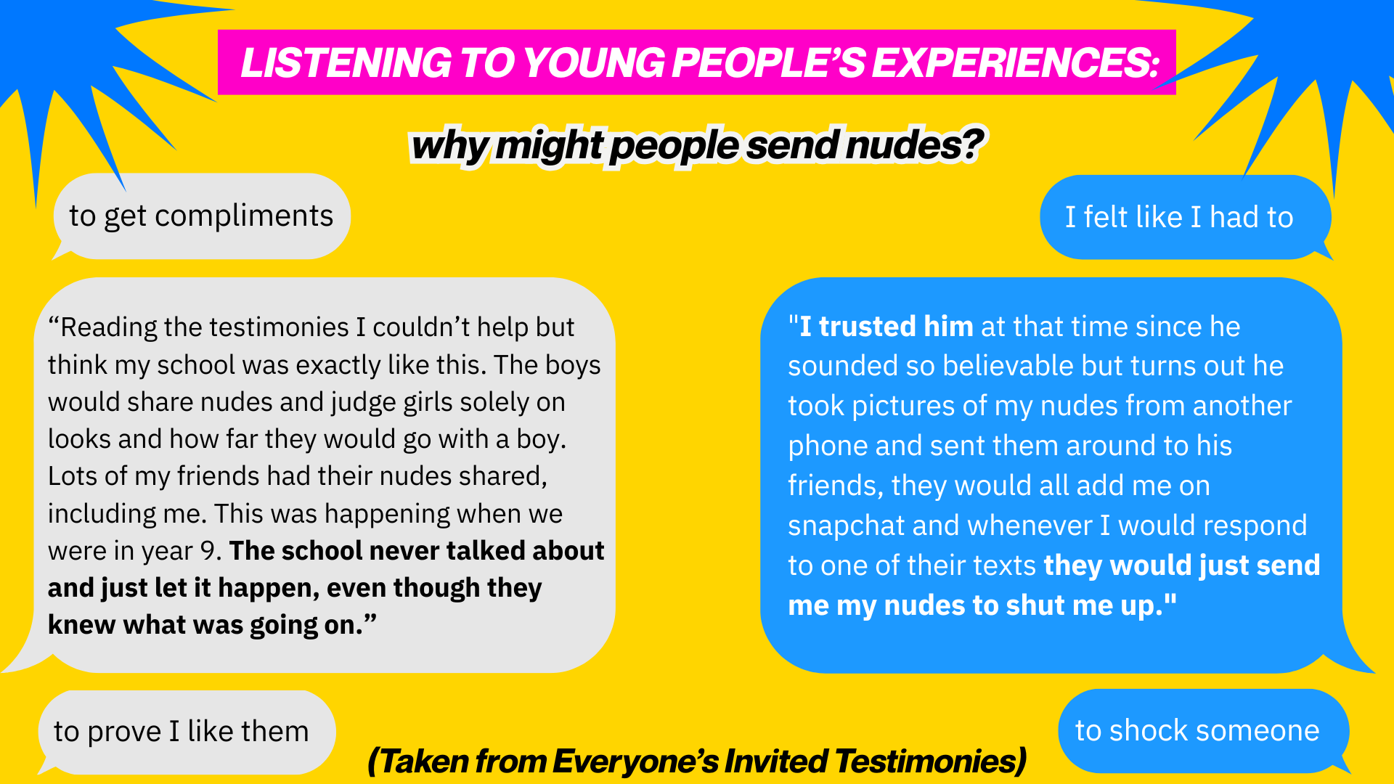

Slide 26
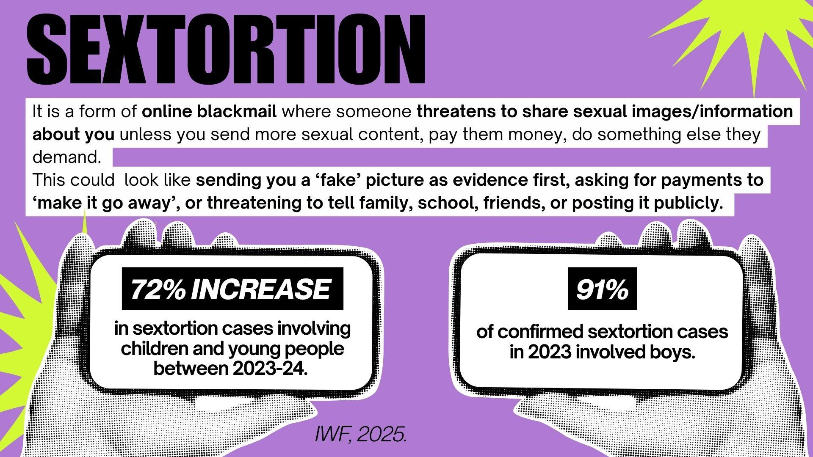

Slide 27
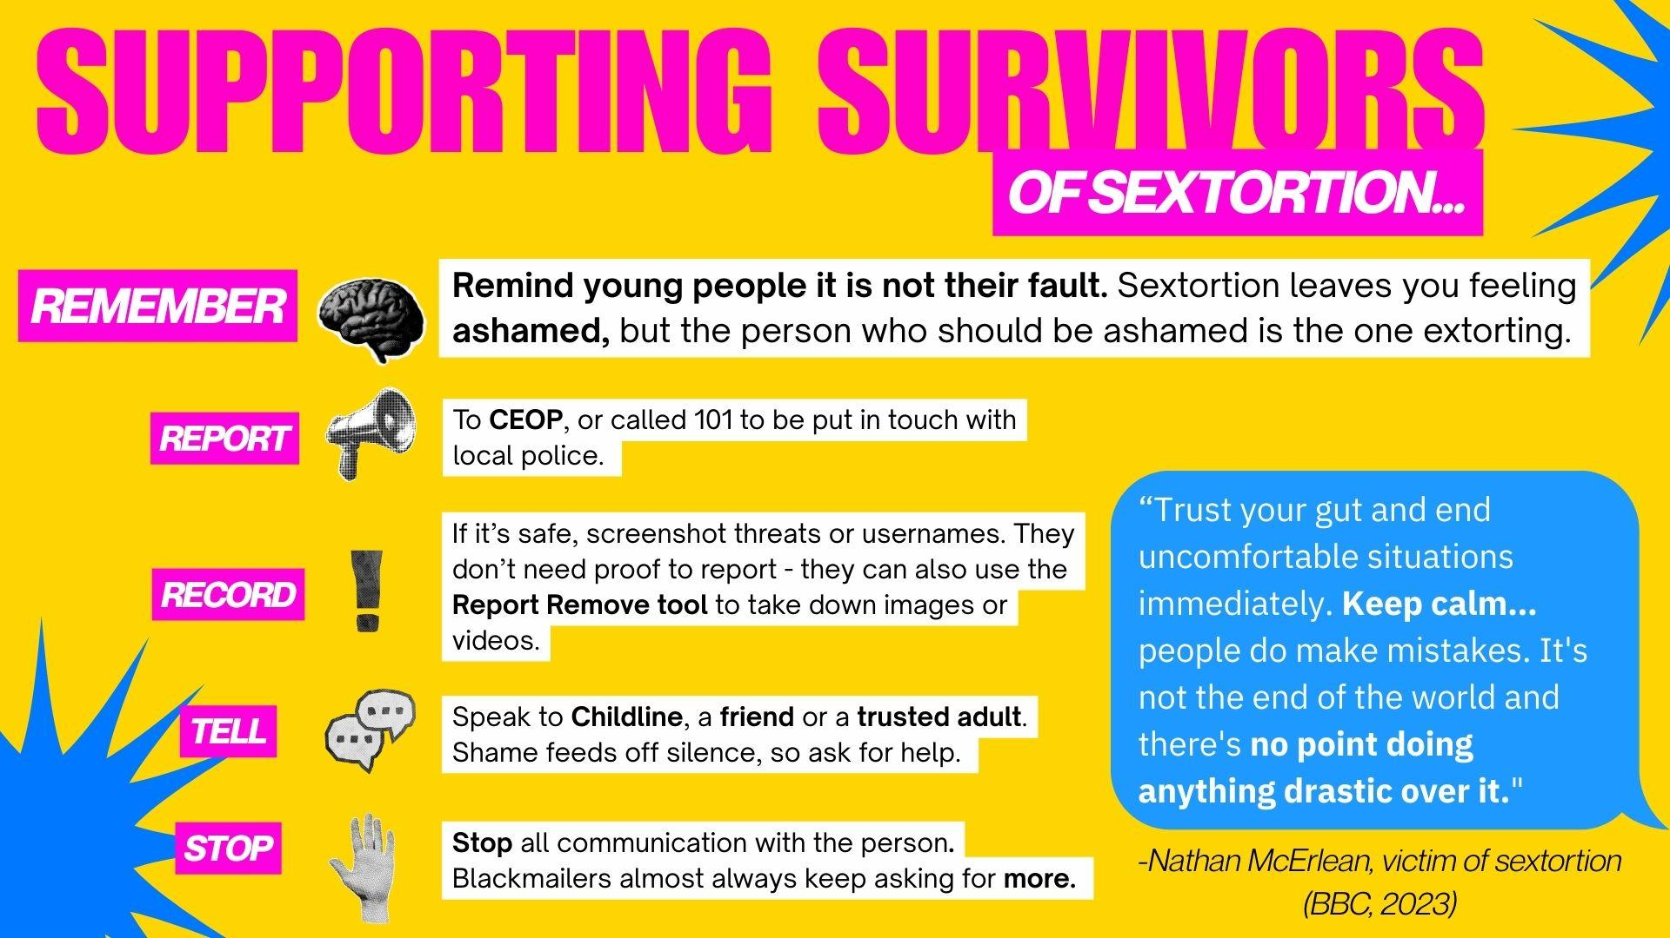

Slide 28
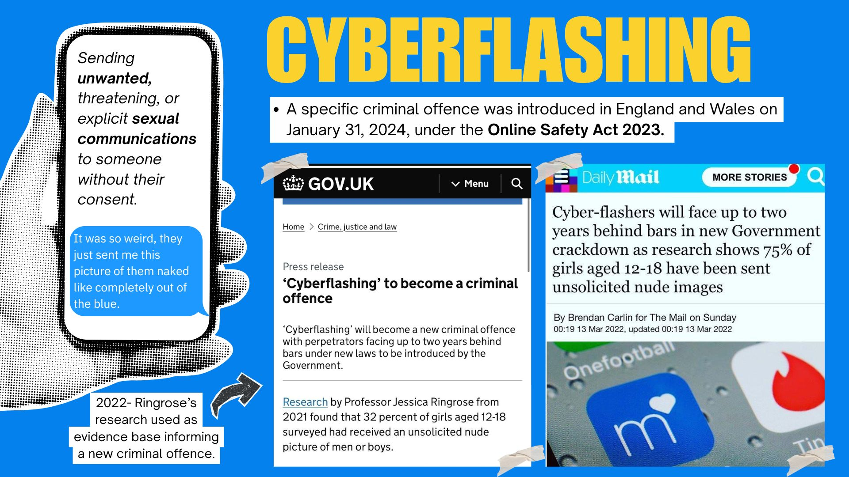

Slide 29
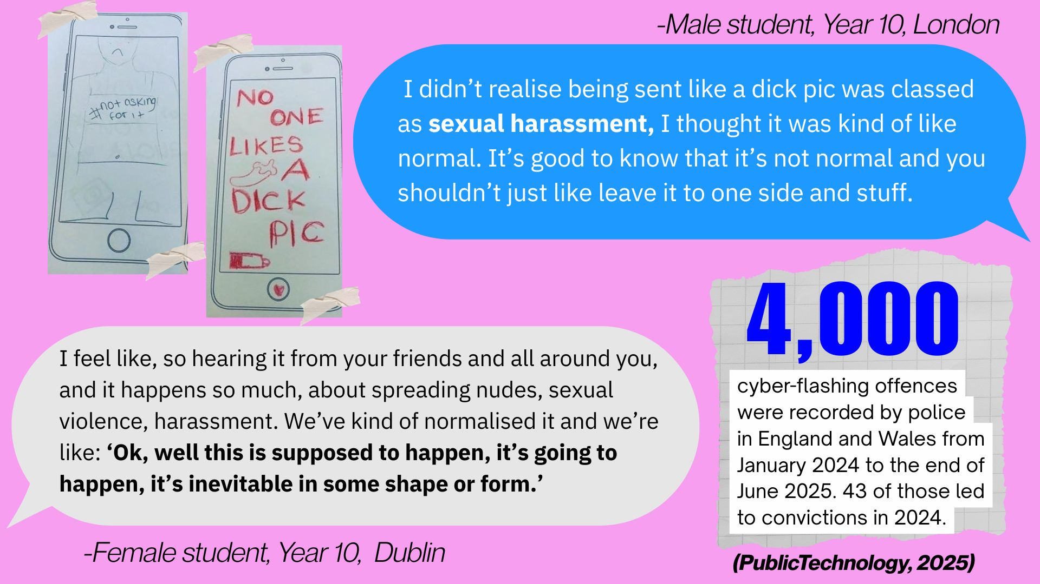

Slide 30
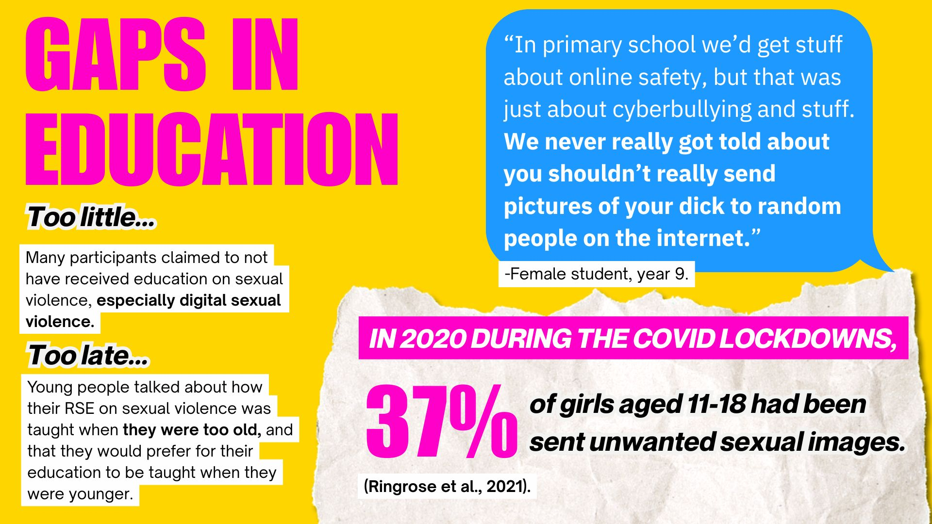

Slide 31
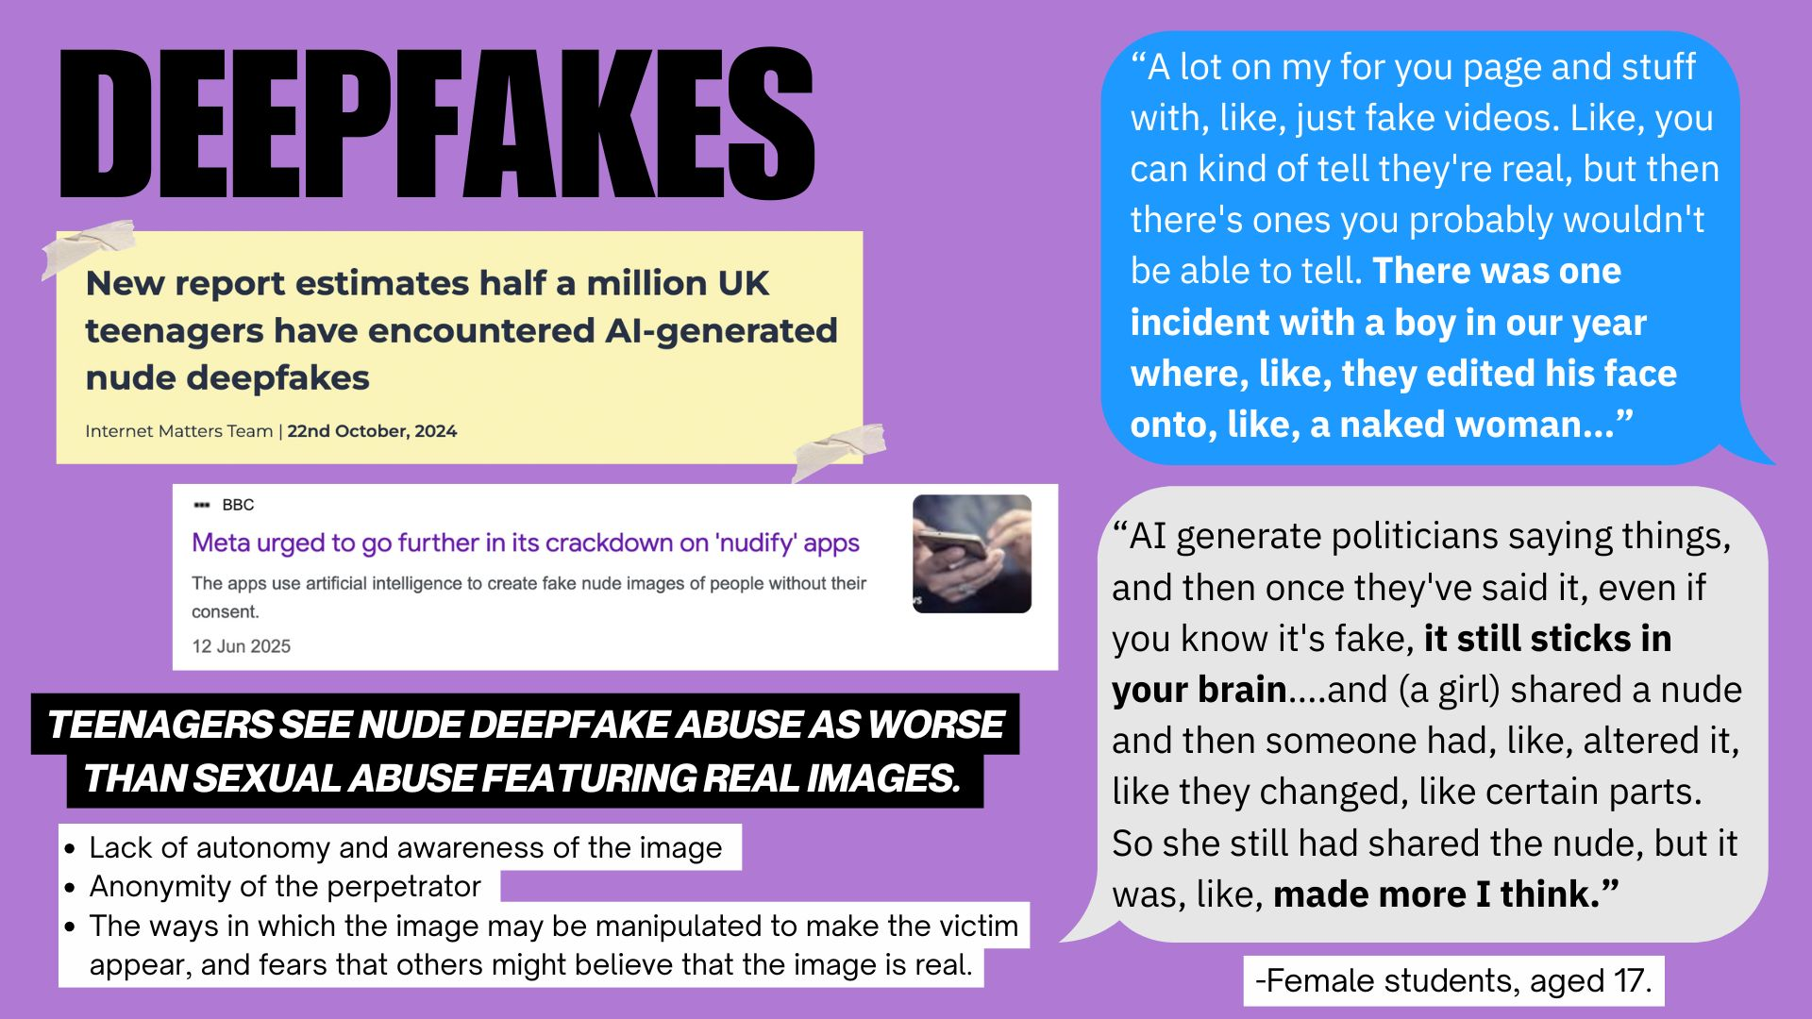

Slide 32


Slide 33
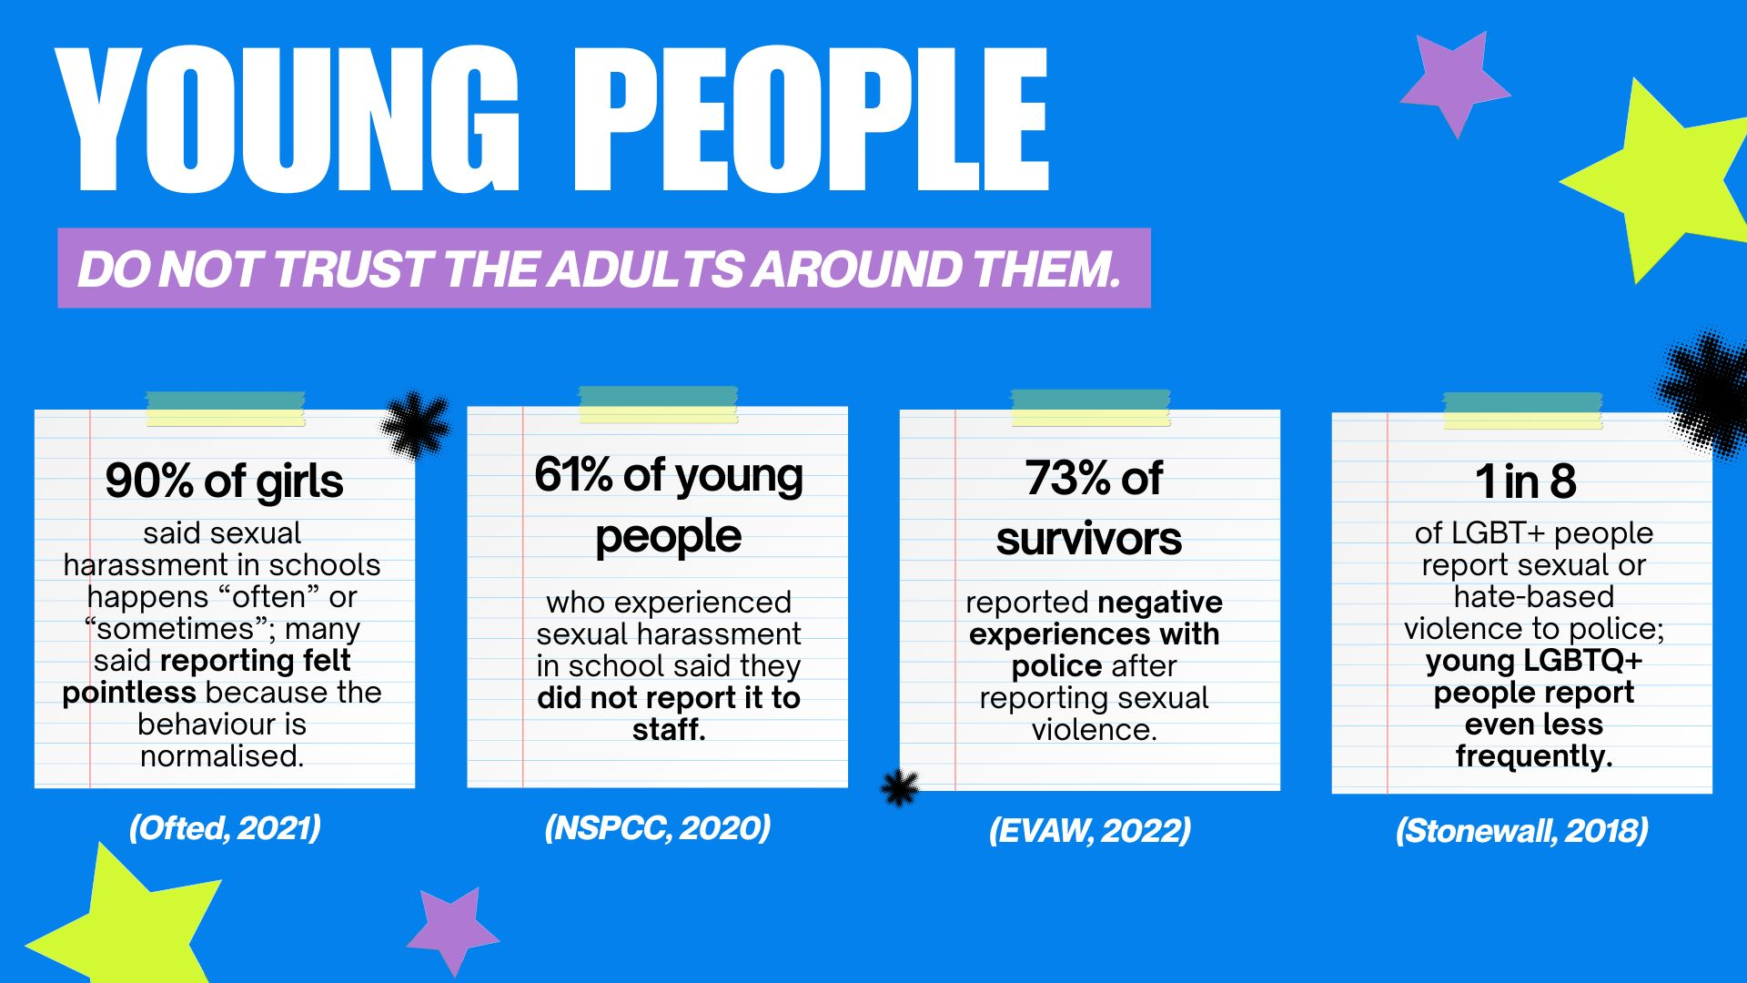
Notes:
Lack of faith in the justice system

Slide 34
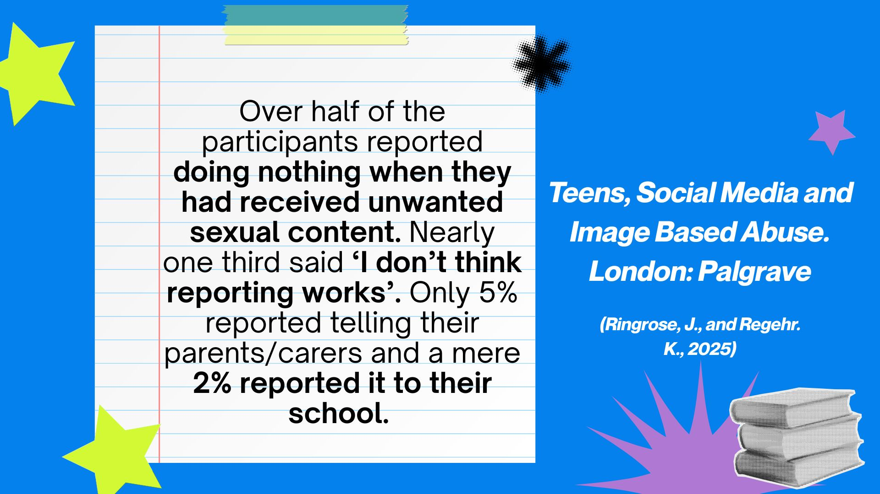

Slide 35
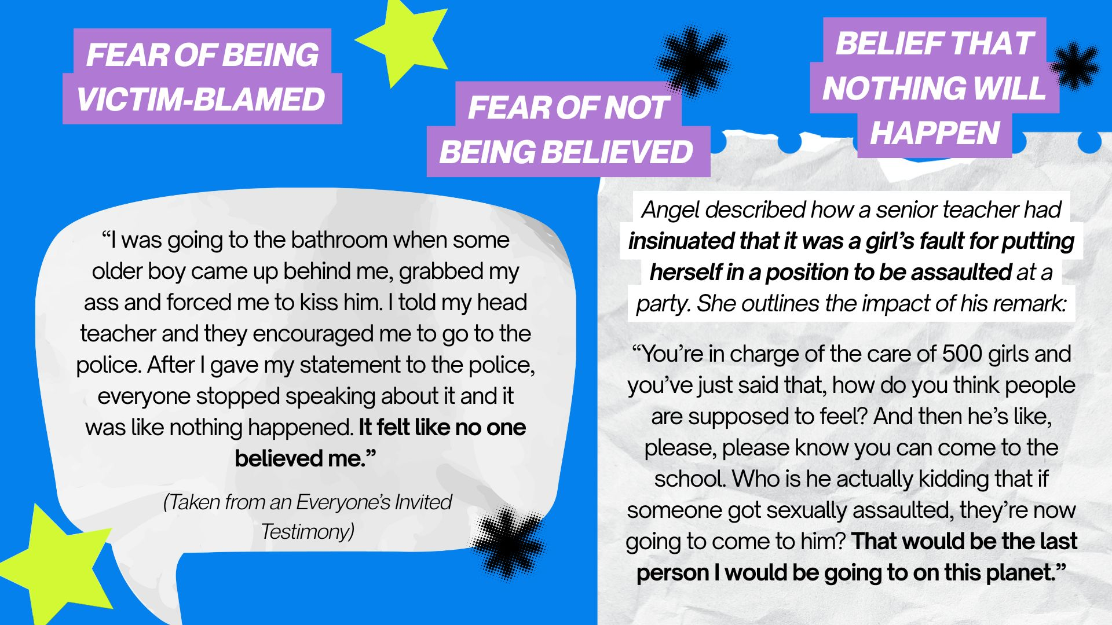

Slide 36
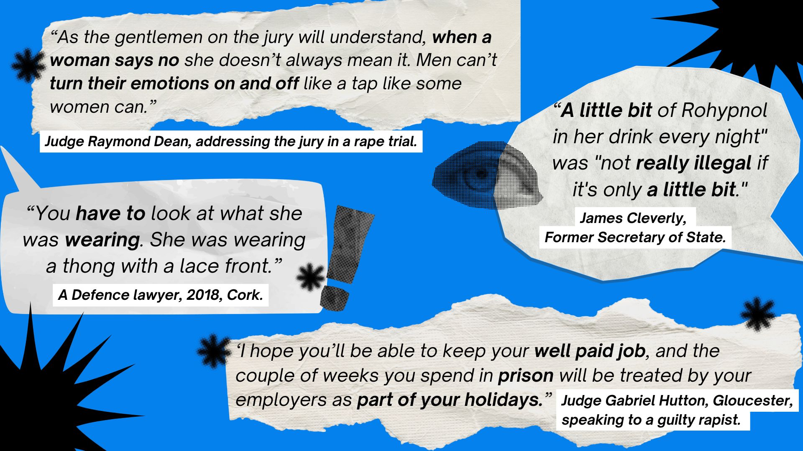

Slide 37
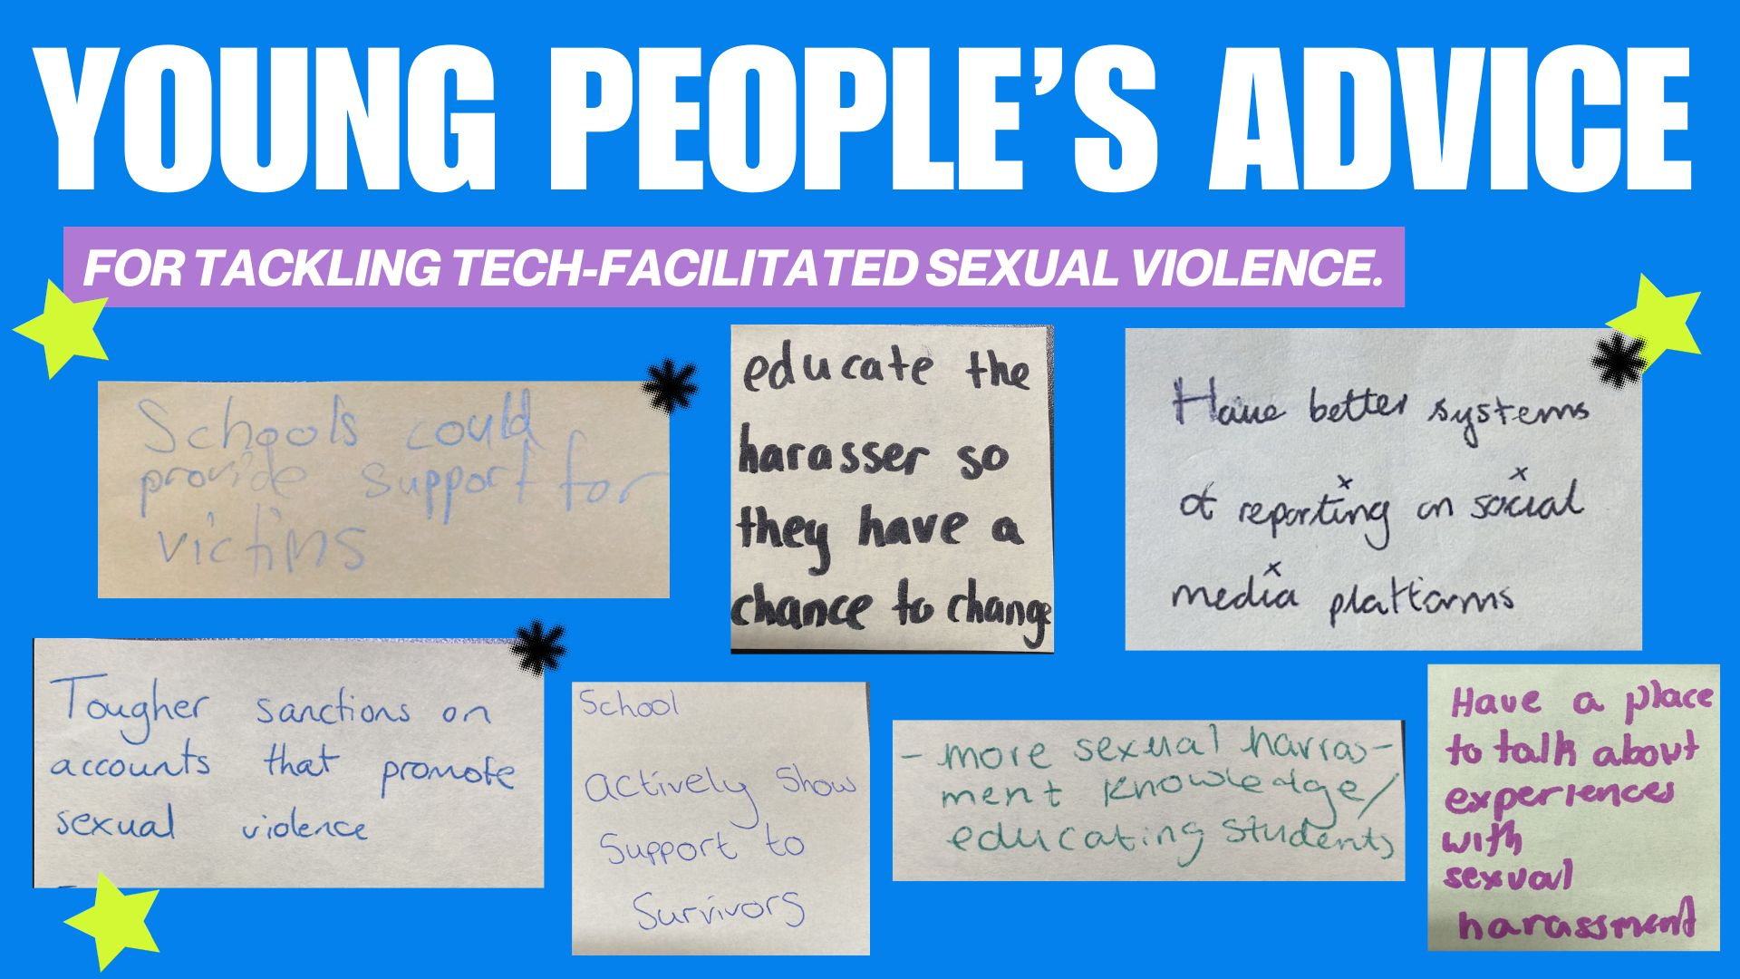

Slide 38
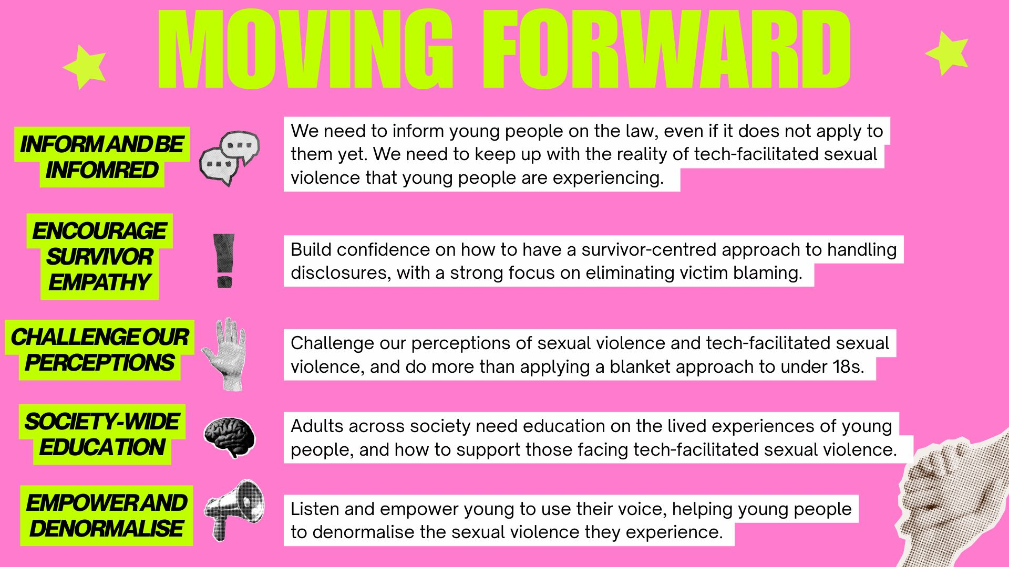
Notes:
Handling disclosures tools, victim-blaming, encouraging survivor empathy, understanding offences (nuances of the laws). ‘Best advice for those in the legal domain’, we’re telling young people they need to know the law even if it doesn’t apply to them (prevention education- stat around young people having sex later). (Inform and become more informed- we educate young people about the law while also challenging our own perceptions).

Slide 39
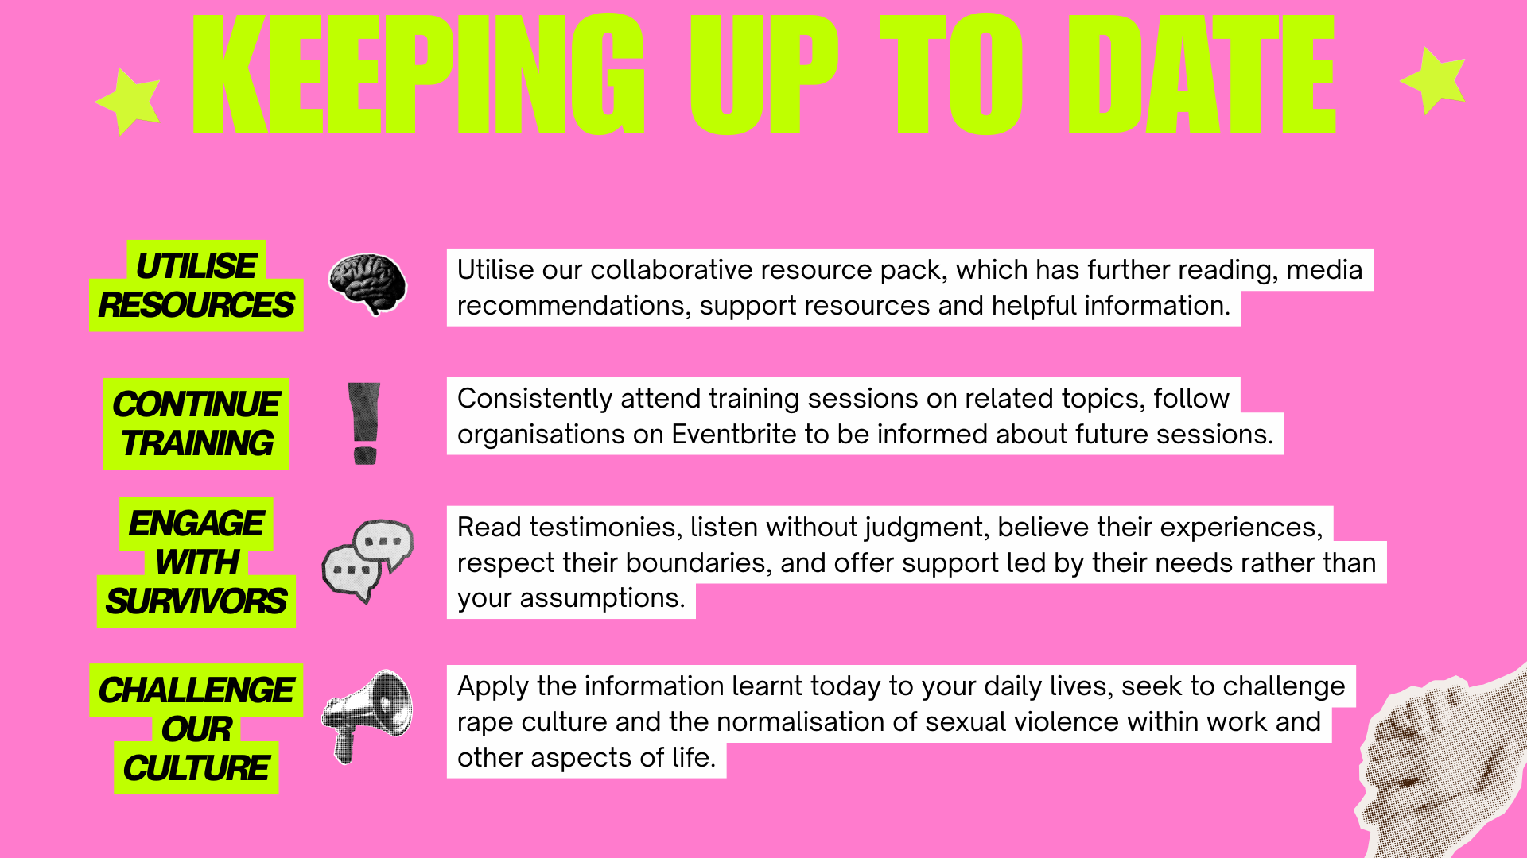
Notes:
Jessica to begin by explaining why it is important to keep up to date

Slide 40

Change for workplaces
Notes:
Change this to more about them

Slide 41


Slide 42
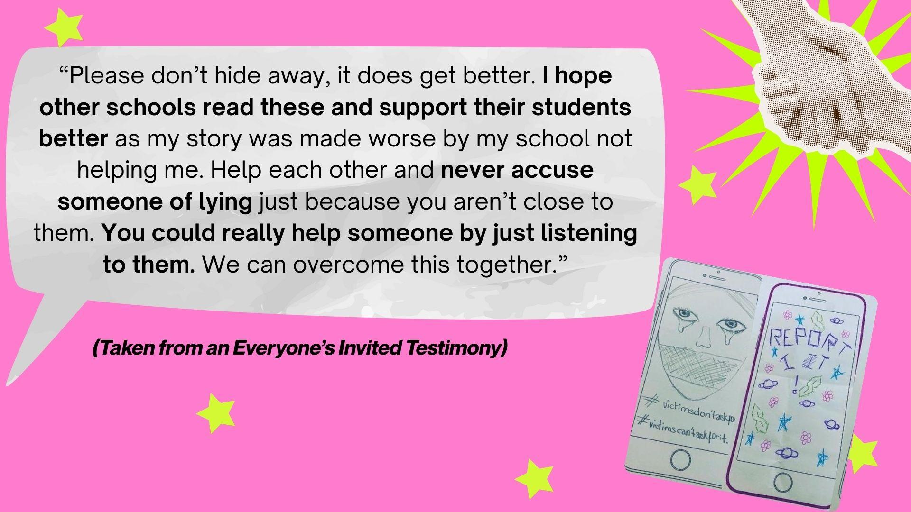

Slide 43
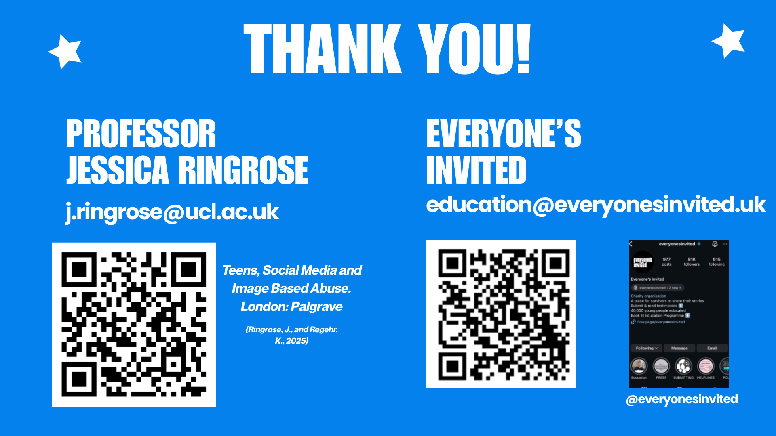
Thank you & Contact details

